Slide 1

PROJECT PHASE - 2

Slide 2
Election Analysis Using Deep Learning

Slide 3
Project By :
G.Jaswanth Reddy – BL.EN.U4CSE15043
G.Hrishikesh– BL.EN.U4CSE15041
D.Chandra mouli - BL.EN.U4CSE15037
Project Guide :
Ms Sreevidya

Slide 4
PROBLEM STATEMENT:
THE MAIN AIM OF THIS PROJECT IS TO ANALYSE THE PRE ELECTION SCENARIO AND HELP THE CANDIDATE.
It is used to extricate, recognize, or portray opinions from different content structures and categorizes them as positive ,neutral and negative.
We made use of both supervised and unsupervised learning approaches.
This project is a continuous evaluating and uses live content to analyze and evaluate the result.
This project mainly focuses on to identifying the sentiment of social media users towards each of the considered state political parties and process this data and extract features, useful insights which help particular candidate to sustain in particular aspects.

Slide 5
Literature Survey
DATA SETS:
Live data based on social media platforms like [ Facebook, quora ]
News articles[unbiased] for particular desired candidates.
Live Twitter Tweets.

Slide 6
FEATURE SET :
There are no specific features at the beginning. The system is empty , it automatically generates the features from the text .
The feature extraction is done by text processing tools .
Each feature is assigned to zero at the start , each varies from (-1to +1).
The reactions to this features are processed and stored in trees.

Slide 7
KEYWORDS:
TWEEPY
TEXT PROCESSING BY TEXTBLOB
FEATURES OF TEXTBLOB
SENTIMENTANALYSIS

Slide 8
DETAILED DESIGN.

Slide 9
HOW IT WORKS ?
It contains two models:
1. Election prediction.
2. Helping the desired candidate to win.

Slide 10
ELECTION PREDICTION (model - 1):
The collection of all the text related to the client , process it and calculate the overall sentiment .
VIEW:
Live news articles
Data cleansing
Text processing
Overall Sentiment calculation
Result

Slide 11
SENTIMENT ANALYSIS
What is Sentiment Analysis?
There’s a couple of definitions, be it by Wikipedia, by Brandwatch, or by Lexalytics. All in all, sentiment analysis boils down to one thing:
It’s the process of analyzing online pieces of writing to determine the emotional tone they carry.
In simple words, sentiment analysis is used to find the author’s attitude towards something. Some tools categorize pieces of writing as positive, neutral, or negative

Slide 12
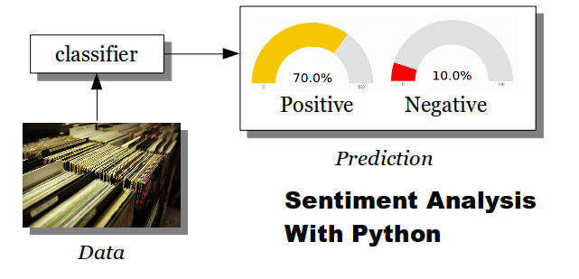
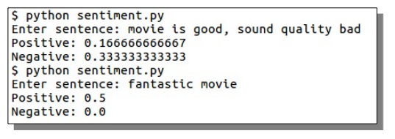
cont..

Slide 13
SYSTEM REQUIREMENTS:
Operating systems | Windows 10 64 bit Windows 8.1 64 bit , windows 8 64 bit, Mac os x
Cpu | Core 2 quad Q6600 at 2.4 GHz or AMD phenom9850 at 2.5 GHz
Memory | 4 GB RAM
Hard drive | 15 GB free space
Software | Anaconda spyder (3.5 or above) python

